Slide 1
TABLE INDEXES AND VIEW
Instructor:

Slide 2

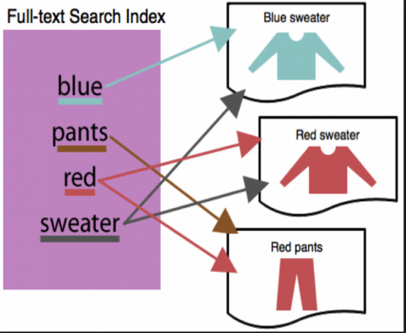
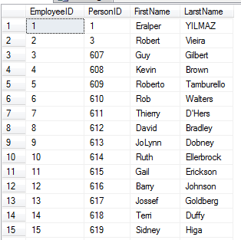
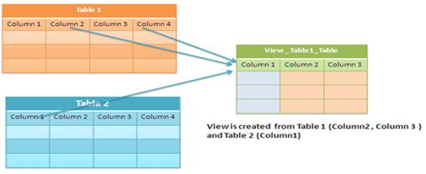
Learning Goals
By the end of this lecture students should be able to:
Create Indexes to improve query retrieval speed
Automatically generate sequence numbers by using a sequence generator
Create, maintain, and use View

Slide 3
Table of contents
Table Indexes
View
Naming Convention And Styles

Slide 4
TABLE INDEXES
Section1
Notes:
Index trong SQL Server | Comdy

Slide 5

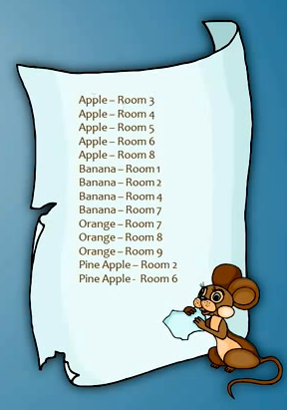





Why use indexes?
An index in database is similar to an index in a book
Indexes in database help speed up search queries. Allow find data in a table without scanning the entire table.
1
2
3
4
5
Late
9
8
7
6
I want bananas …
Result:
1
2
3
4
5
Quick
9
8
7
6

Slide 6
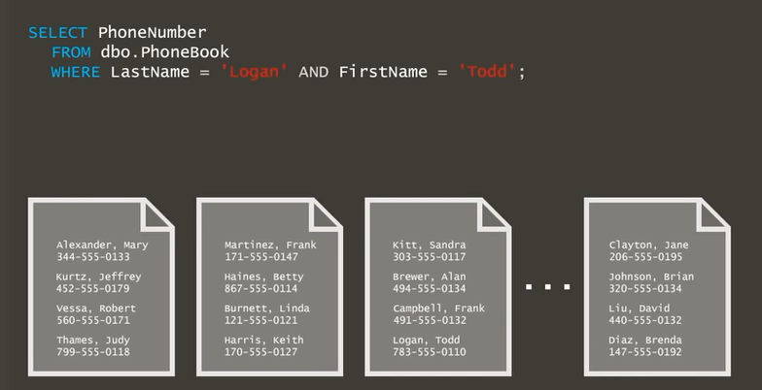
Table Indexes (1/3)
CREATE TABLE dbo.PhoneBook (
LastName varchar(50) NOT NULL,
FirsName varchar(50) NOT NULL,
PhoneNumber varchar(50) NOT NULL
);

Slide 7
Table Indexes (2/3)
CREATE TABLE dbo.PhoneBook (
LastName varchar(50) NOT NULL,
FirsName varchar(50) NOT NULL,
PhoneNumber varchar(50) NOT NULL
);
Result:
783-555-0110

Slide 8
Table Indexes (1/3)
There are 2 types of major Indexes:
Clustered
Data is stored in the order on the clustered index
Only 1 clustered index per table
Usually the Primary Key
Sort and store the data rows in the table based on their key value.
Non-clustered
Data is not stored in the order on the non clustered index
Have a structure completely separate from the data rows.

Slide 9
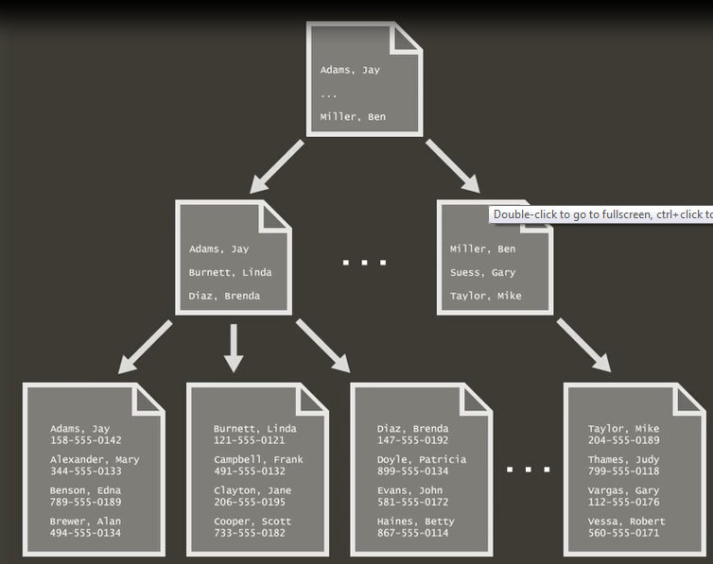
Clustered Index
CREATE CLUSTERED INDEX IX_PhoneBook_CI
ON dbo.PhoneBook (LastName, FirstName)
Index
Data

Slide 10
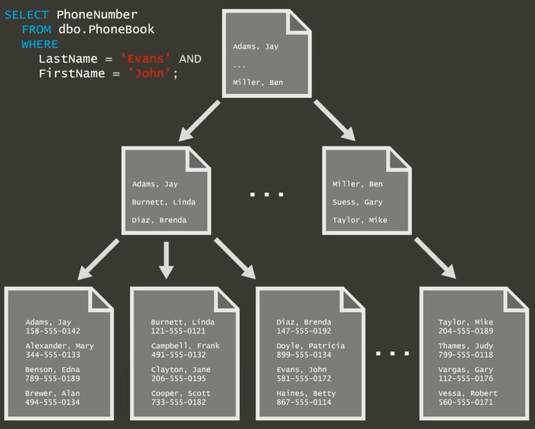
Clustered Index

Slide 11
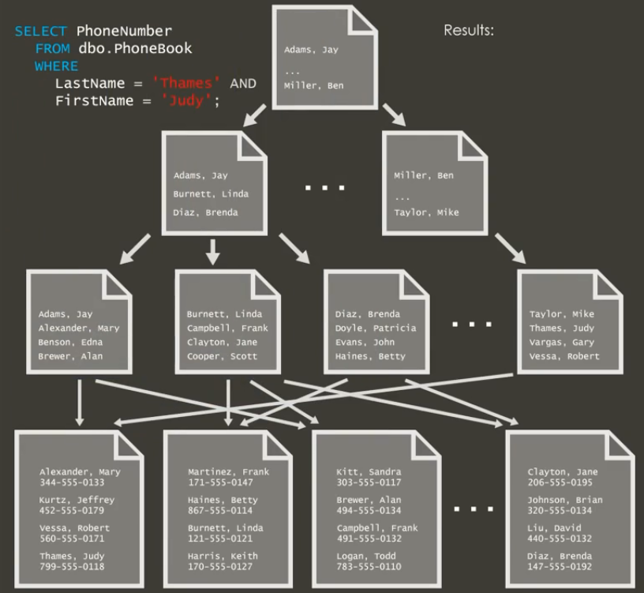

Non - Clustered Index

Slide 12
Creating an Index
Create a new index:
Deleting an Index
CREATE INDEX index_name ON table_name (column1_name, column2_name, …)
DROP INDEX table_name.index_name

Slide 13
VIEWS
Section2

Slide 14
What is a view?
A View is a logical or virtual table. The fields in a view are fields from one or more real tables in the database.
There are two major reasons you might want to use views:
Views allow you to limit the data users can access
Views reduce complexity for end users.
Notes:
Database views allow you to create virtual tables based upon query results.
There are two major reasons you might want to use views instead of provid-
ing users with access to the underlying database table(s) themselves:
Views allow you to limit the data users can access. For example, you
can create a view that returns only certain rows from a table and then
grant users permission to access the view. They won’t be able to access
rows in the table that don’t meet the criteria of the view.
Views reduce complexity for end users. If end users aren’t comfortable
writing complex SQL queries, you can write the query for them and then
hide the complexity in a view

Slide 15
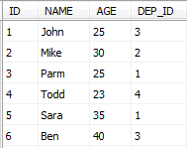
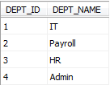
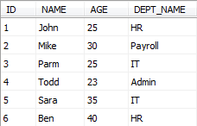
Creating a view
CREATE VIEW View_Name [list of column names]
AS
SELECT…
Table: DEPARTMENT
Example:
Table: EMP
CREATE VIEW view_EmployeeByDpt
AS
SELECT ID, NAME, AGE, DEPT_NAME
FROM EMP, DEPARTMENT
WHERE EMP.DEP_ID = DEPARTMENT.DEPT_ID
view_EmployeeByDpt
SELECT * FROM view_EmployeeByDpt

Slide 16

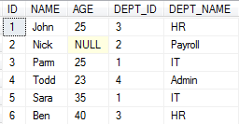

Deleting a view
Syntax:
Example:
DROP VIEW View_Name
DROP VIEW view_EmployeeByDpt
view_EmployeeByDpt

Slide 17
NAMING CONVENTION AND STYLES
Section3

Slide 18
NAMING CONVENTION AND STYLES
Use UPPER CASE for all T-SQL constructs, excepts Types
Correct:
SELECT MAX([Salary]) FROM dbo.[EmployeeSalary]
Incorrect:
SELECT max([Salary]) from dbo.[EmployeeSalary]
Use lower case for all T-SQL Types and Usernames
Correct:
DECLARE @MaxValue int
Incorrect:
DECLARE @MaxValue INT

Slide 19
NAMING CONVENTION AND STYLES
Use Pascal casing for all UDO’s
Correct:
CREATE TABLE dbo.EmployeeSalary
(
EmployeeSalaryID INT
)
Incorrect:
CREATE TABLE dbo.Employeesalary
(
EmployeesalaryID int
)

Slide 20
NAMING CONVENTION AND STYLES
Avoid abbreviations and single character names
Correct:
DECLARE @RecordCount int
Incorrect:
DECLARE @Rc int
UDO naming must confer to the following regular expression ([a-zA-Z][a-zA-Z0-9]).
Do not use any special or language dependent characters to name objects. Constraints can use the underscore character.
Correct:
CREATE TABLE dbo.[EmployeeSalary]
Incorrect:
CREATE TABLE dbo.[Employee Salary]

Slide 21
NAMING CONVENTION AND STYLES
Use the following prefixes when naming objects
usp_: User stored procedures
ufn_: User defined functions
view_: Views
IX_: Indexes
usp_: User stored procedures
DF_: Default constraints
PK_: Primary Key constraints
FK_: Foreign Key constraints
CHK_: Check constraints
UNI_: Unique constraints
Correct:
CREATE PROCEDURE dbo.usp_EmployeeSelectAll
Incorrect:
CREATE PROCEDURE dbo.EmployeeSelectRetired –-without preffixed

Slide 22
NAMING CONVENTION AND STYLES
Name tables in the singular form
Correct:
CREATE TABLE dbo.[Employee]
Incorrect:
CREATE TABLE dbo.[Employees]
Tables that map one-to many, many-to-many relationships should be named by concatenating the names of the tables in question, starting with the most central table’s name.
Correct:
CREATE TABLE dbo.[EmployeeSalary]

Slide 23

Summary
Table Indexes
Why use indexes?
Create, maintain and use index
View
Create, maintain and use view
Naming convention
Demo
View

Slide 24
Thank you
‹#›

